Slide 1


Data Science with Python Career Program - Capstone Project
BY – PRANAV BANSAL

Slide 2

AGENDA
Data Exploration
Data Insights
EDA Graphs
Graphical Analysis and Conclusion on Dataset
Data Cleaning and Data Preprocessing steps
ML Modeling
Deployment of ML Models using Streamlit
Conclusion
References

Slide 3
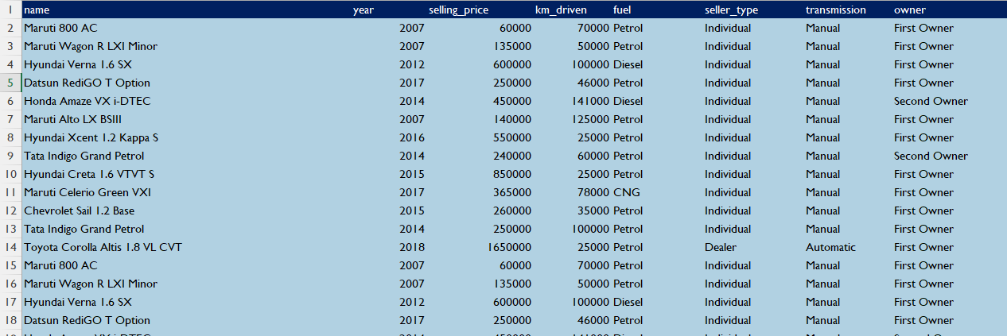
Data Exploration
The Car Details dataset contains previous selling prices of cars, which includes various parameters such as kilometers driven, year of manufacture, fuel type, type of owner, seller type, and transmission. We will be using advanced statistical and machine learning techniques to analyze the data and build a robust model that can accurately predict the selling price of a car.

Slide 4

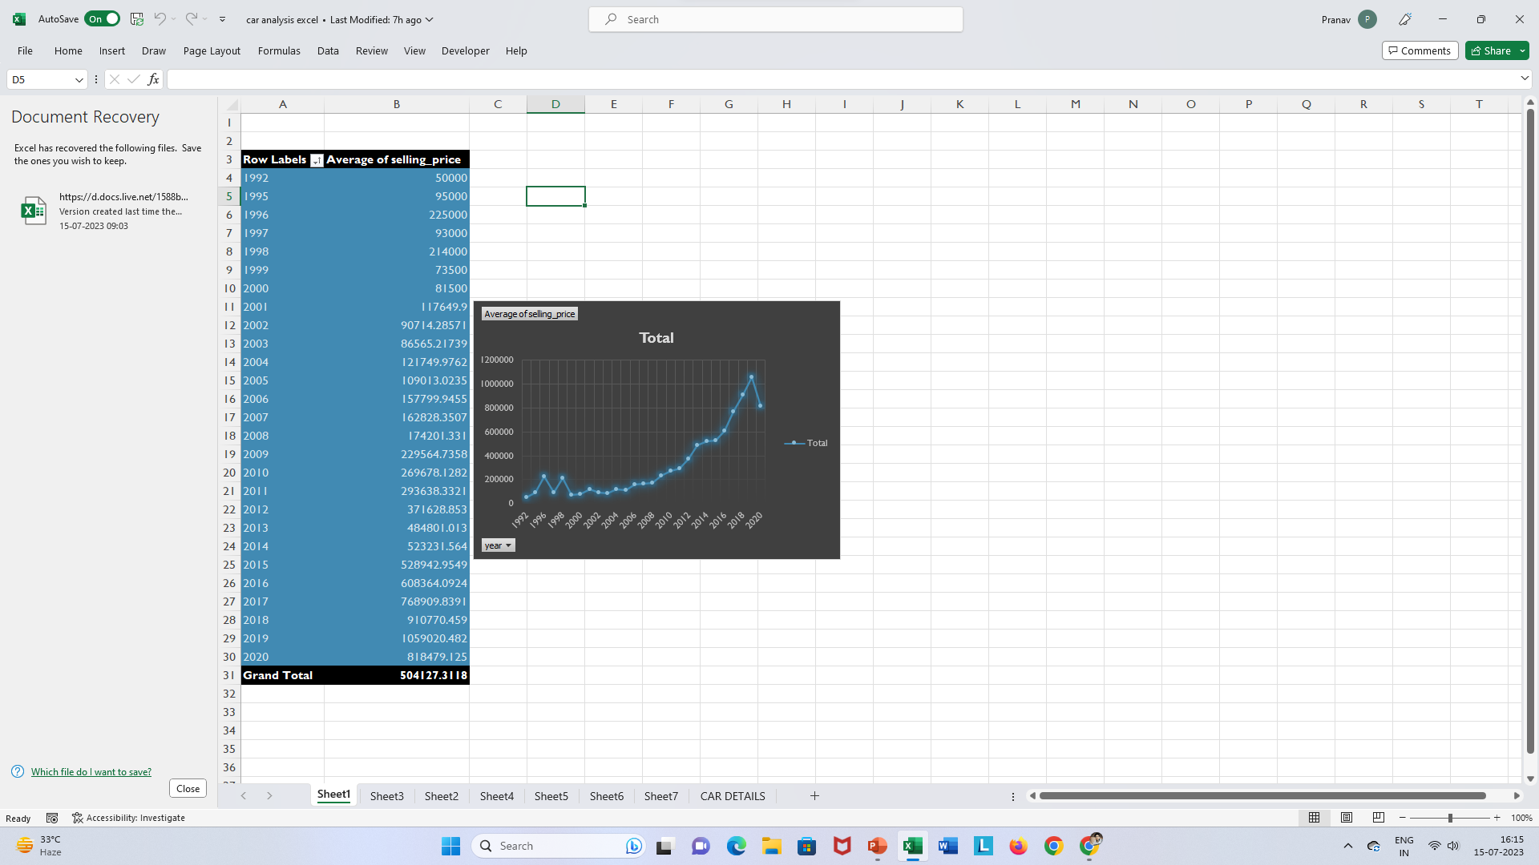
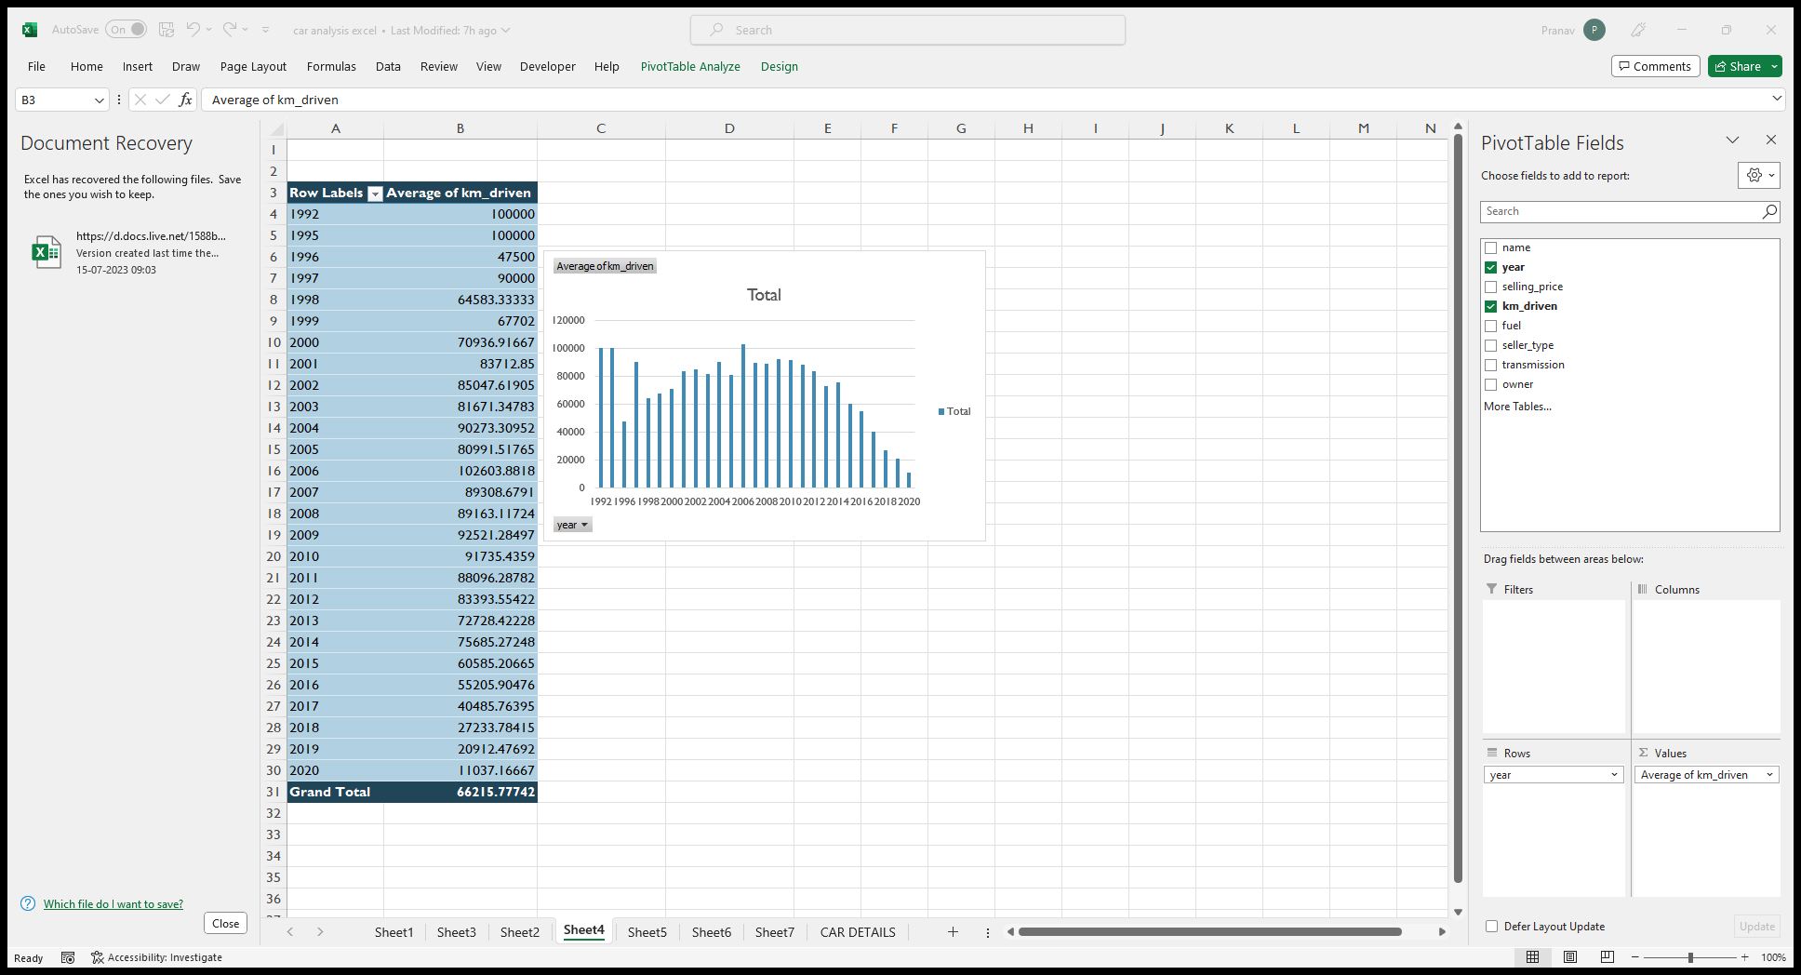
Data Insights
In the Year 1992, the average selling price of cars were lowest, But with the passing of years the average selling price of cars keeps on increasing. It increases from 50,000 to 1059020.482 in 2019 . But In 2020 it starts declining.
If we see in km driven , with the passing of years the km driven of the cars goes on decreasing.. In 2006 it is the highest which is 102603.8818 , but after 2006 , it keeps on decreasing.

Slide 5
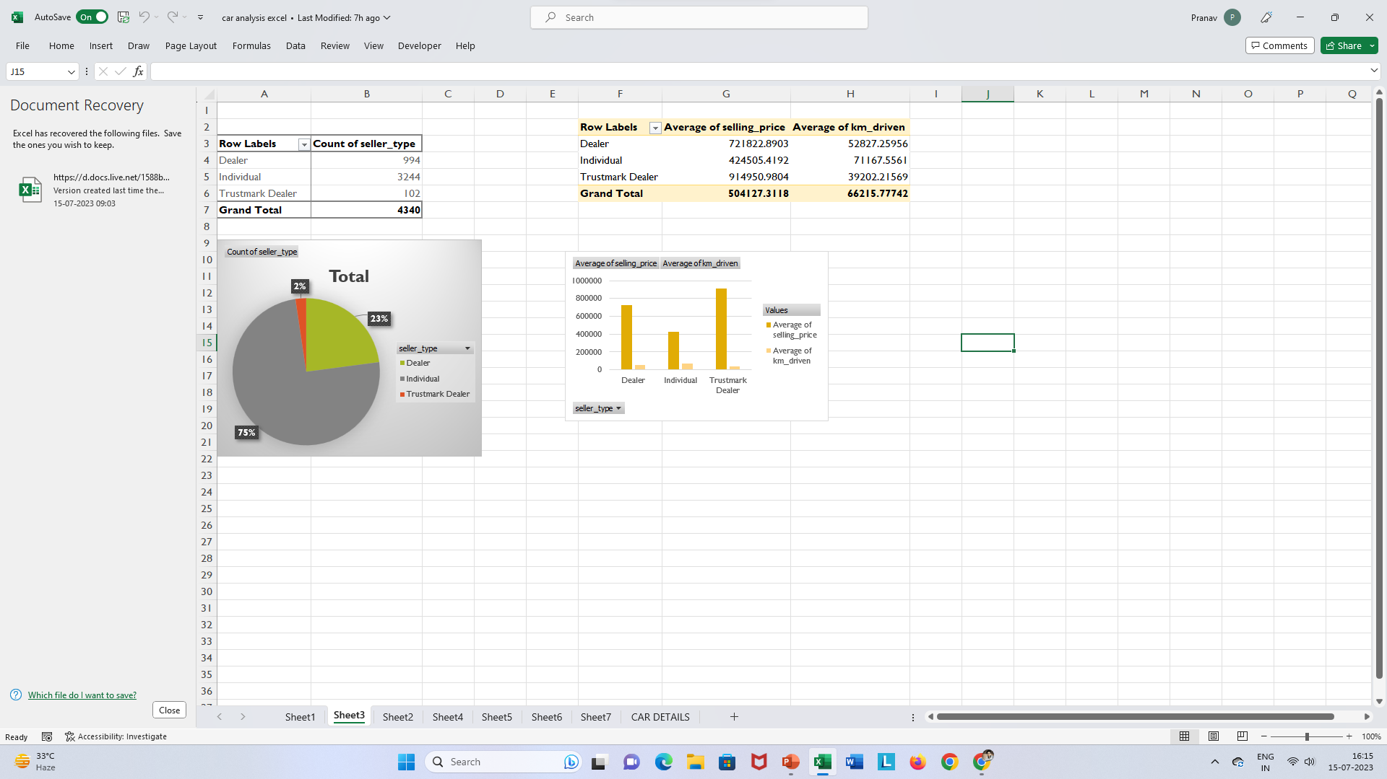
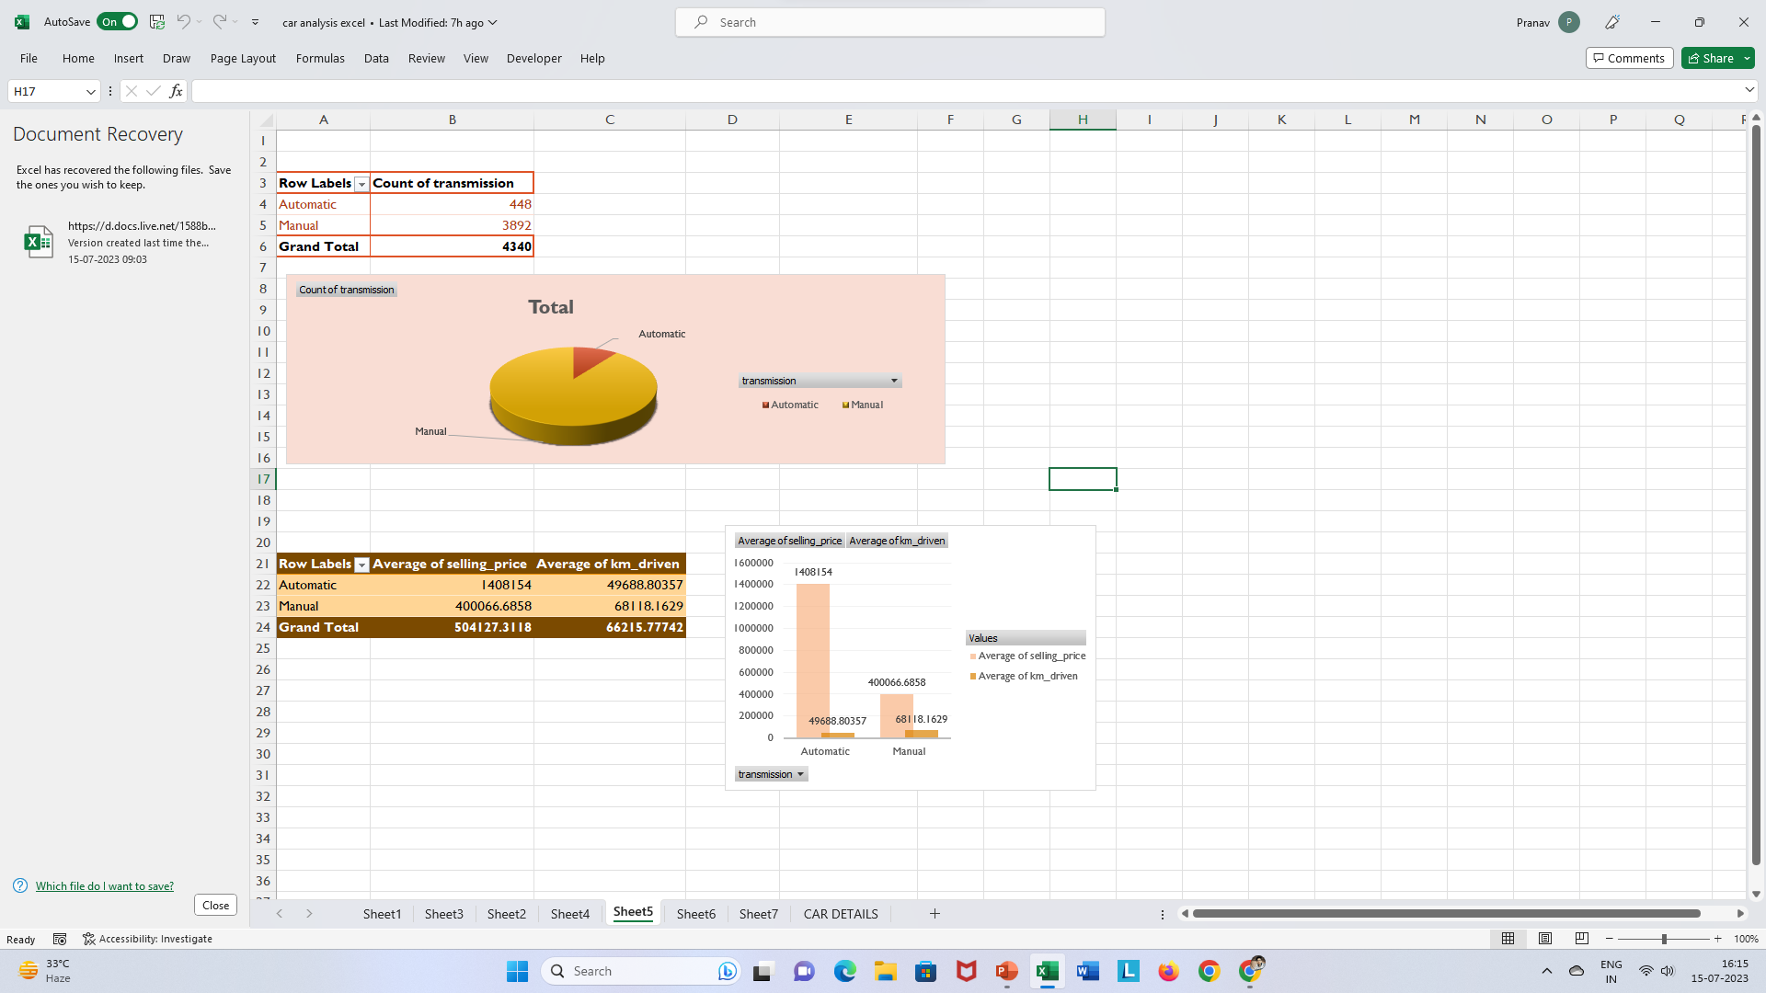
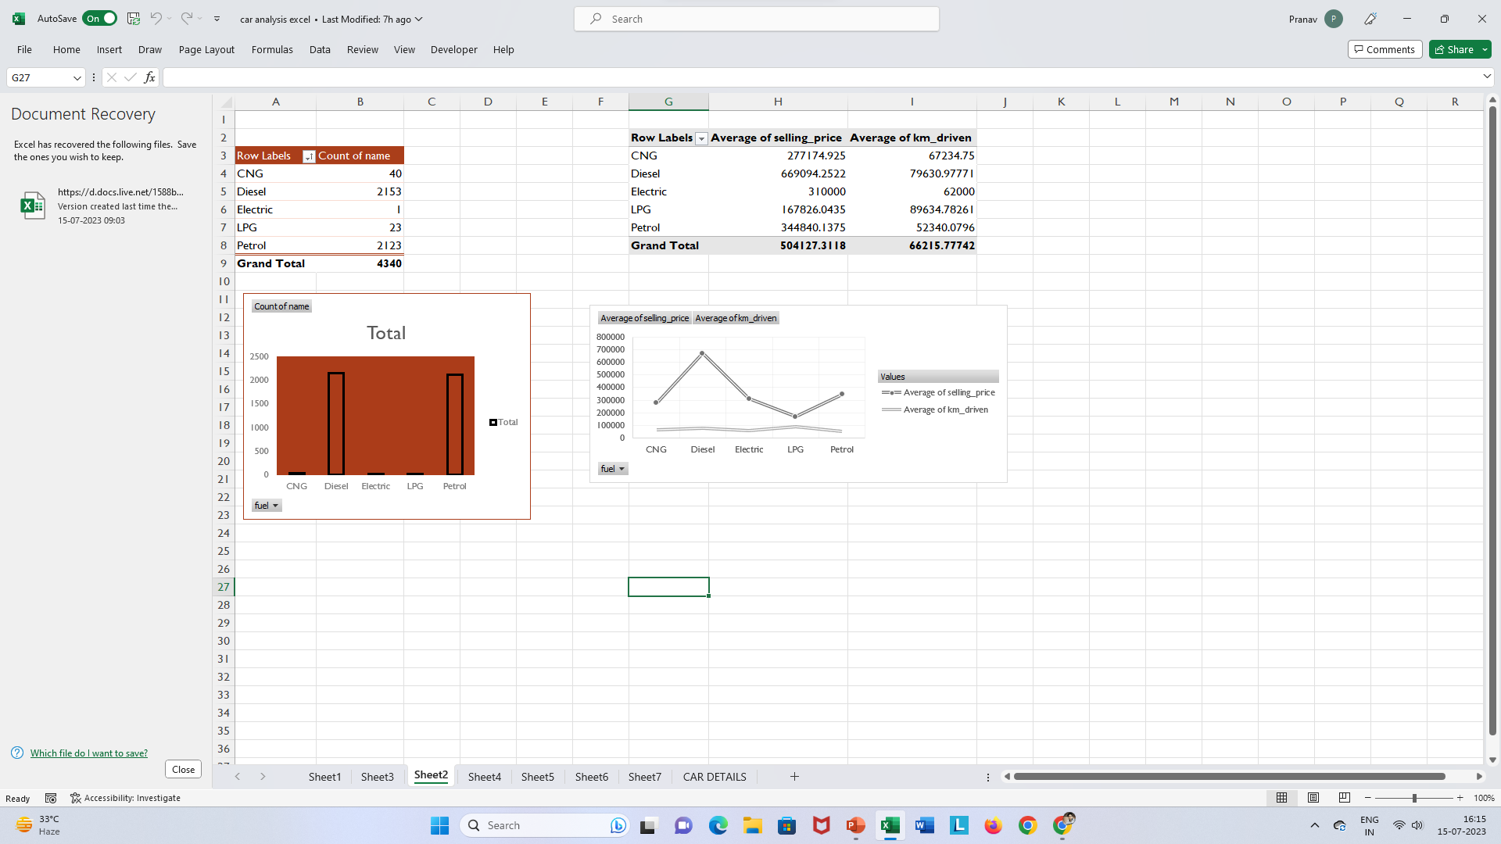
Data Insights
My findings from this Analysis is that there are large number of cars having diesel fuel type, and the average selling price of diesel type cars are higher than other fuel type cars, but the LPG fuel type cars having the highest average km driven.In reference to transmission, the average selling price of manual cars are lower than automatic cars which means people prefer more manual cars. It is clearly observe that Trustmark dealers deals with high selling price cars and the dealers seller type sold more km driven cars than other seller types.

Slide 6
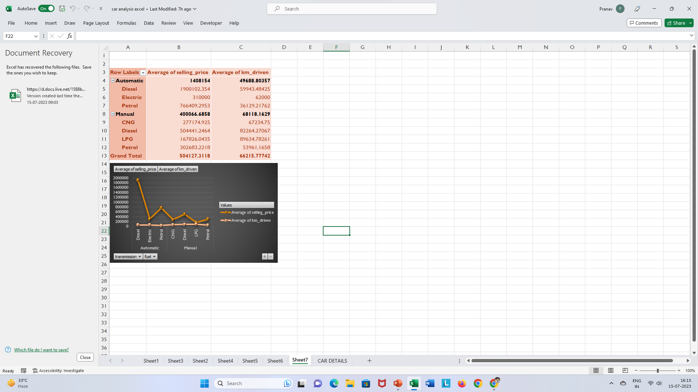
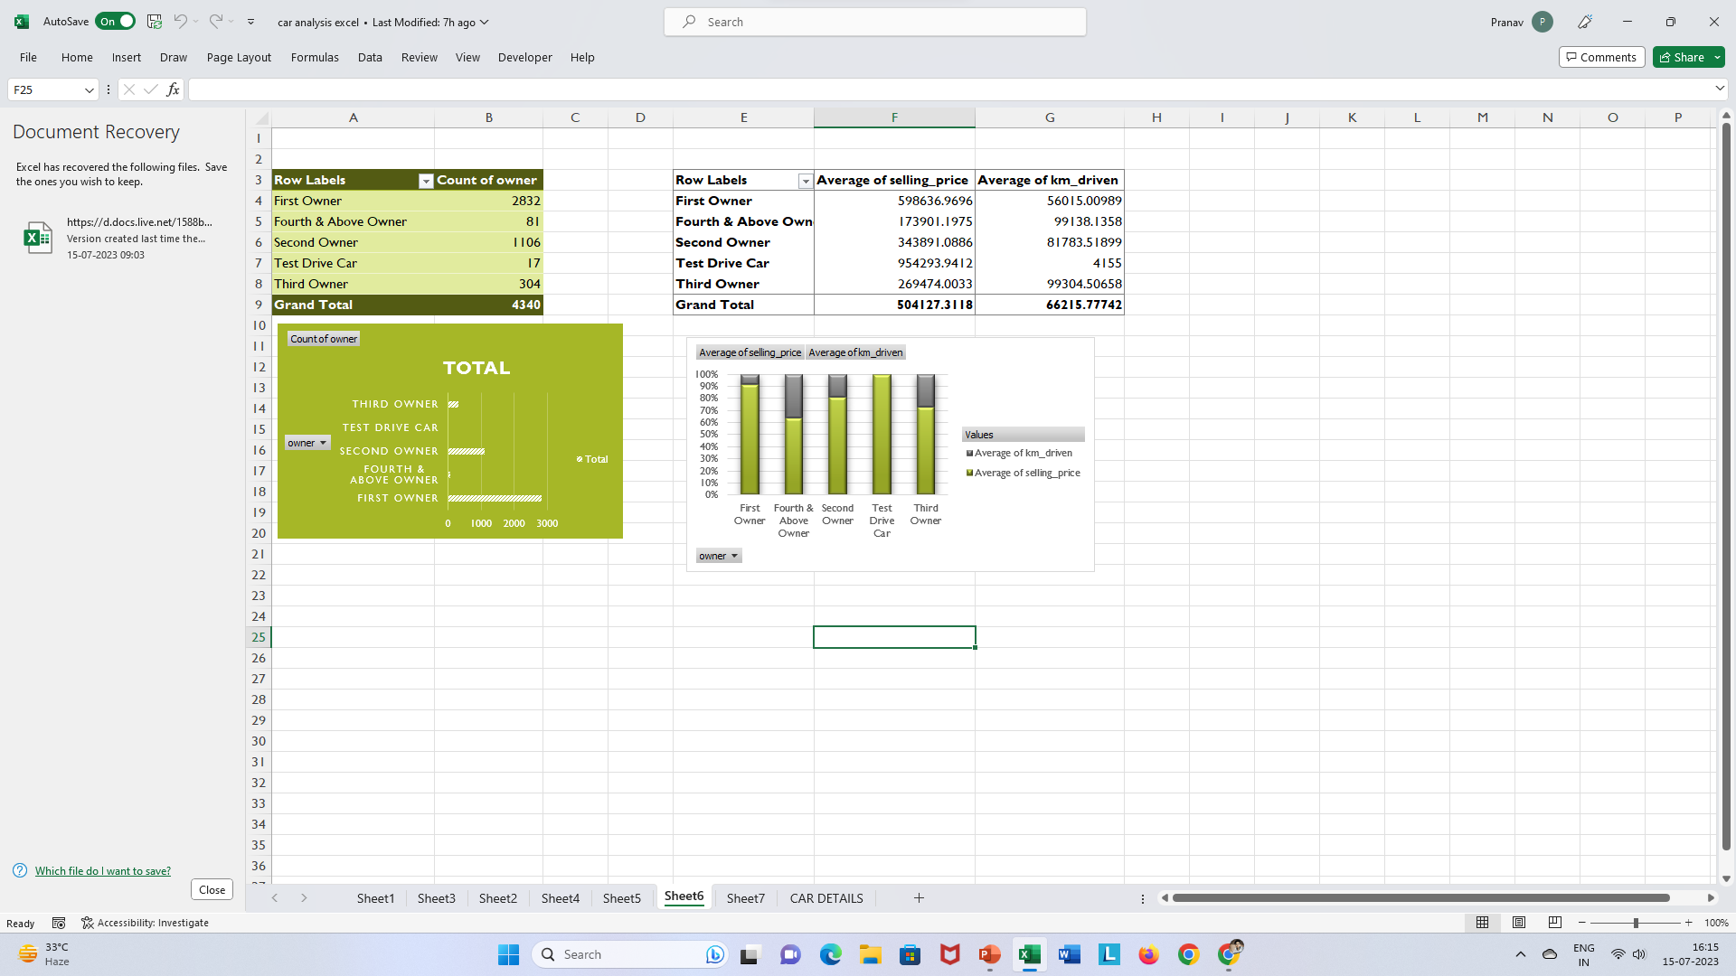
Data Insights
From these features the analysis is that most no. of cars are sold to first owners and the average selling price of test drive cars are high than other owners because they own high selling price cars. It is alse seen that Automatic cars have no CNG and LPG fuel type cars and the average selling price of manual cars are higher than automatic cars. In manual type cars people mostly prefer CNG cars whereas In automatic cars people mostly prefer electric cars.

Slide 7
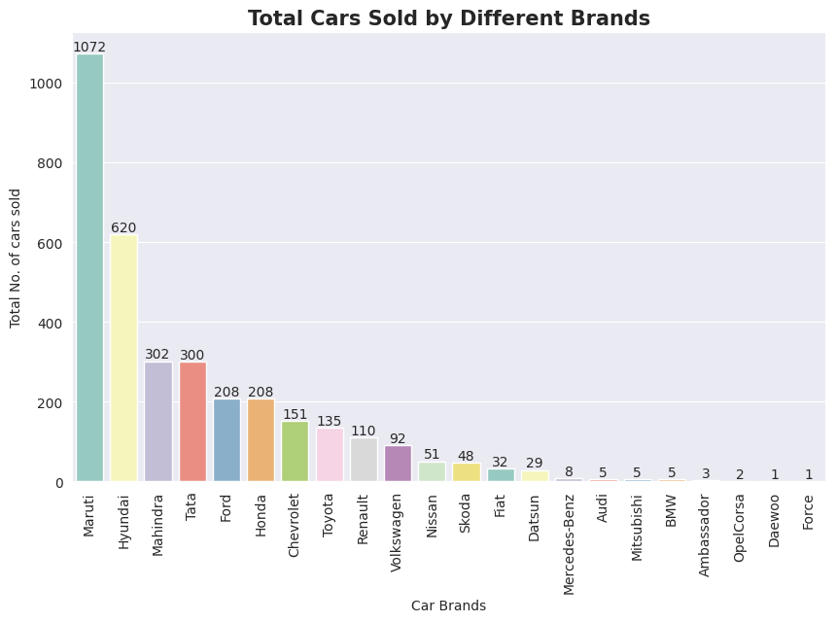
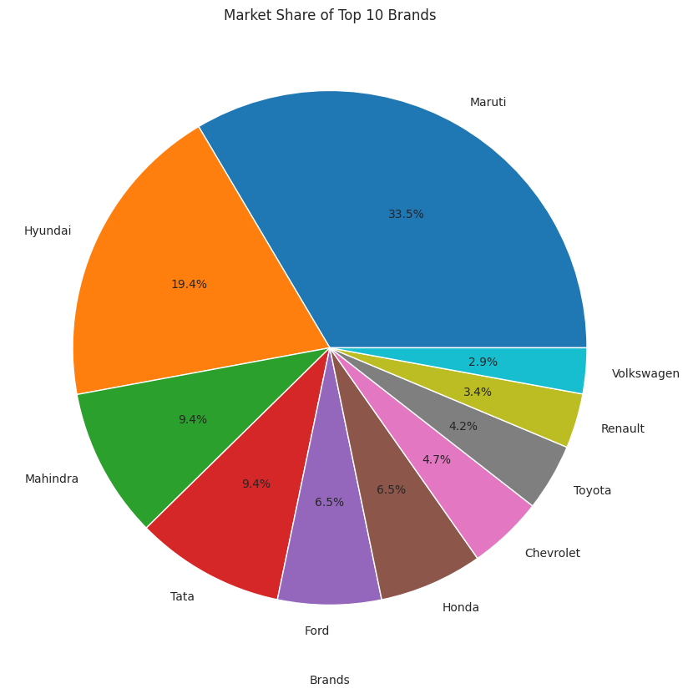
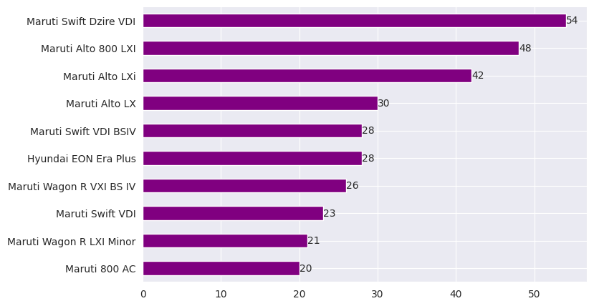
EDA Graphs
# Importing Libraries
import pandas as pd
import matplotlib.pyplot as plt
import seaborn as sns
%matplotlib inline
sns.set_style('darkgrid')
import warnings
warnings.filterwarnings('ignore')

Slide 8
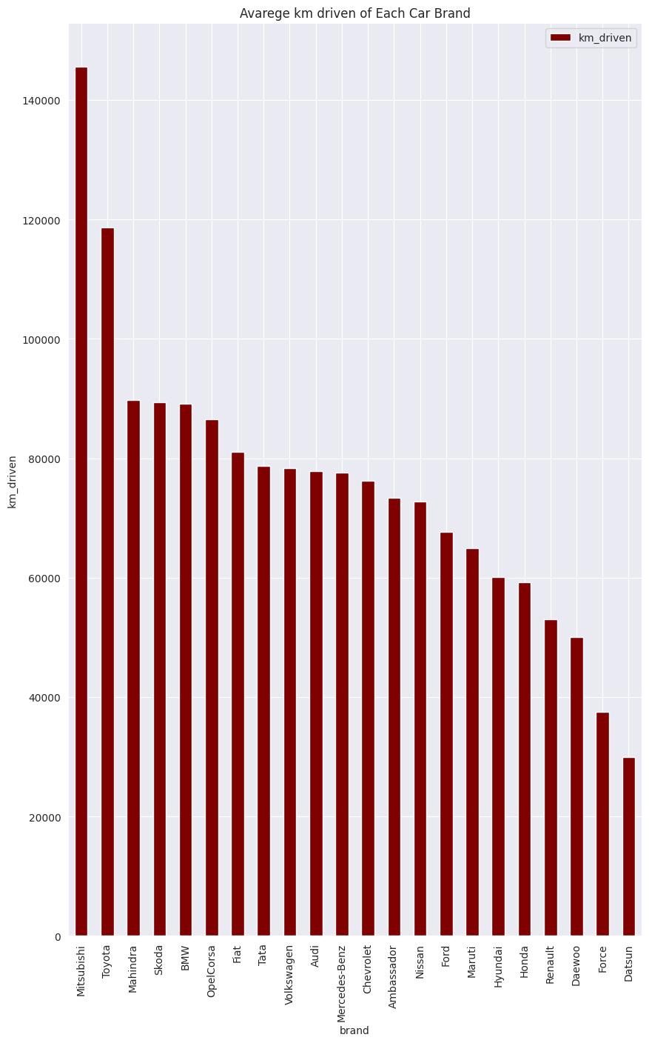
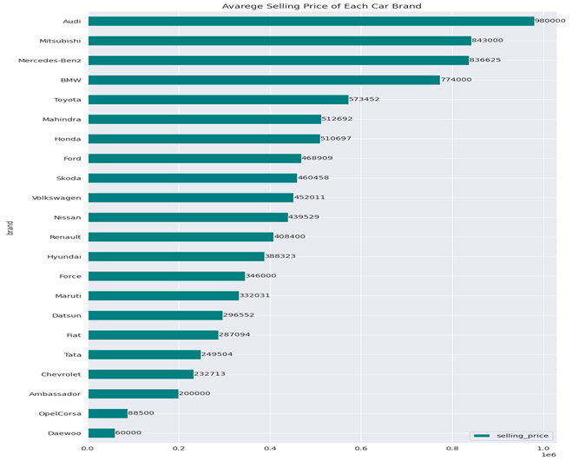
EDA Graphs

Slide 9
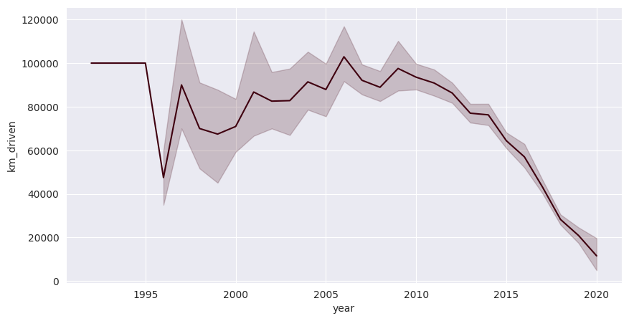
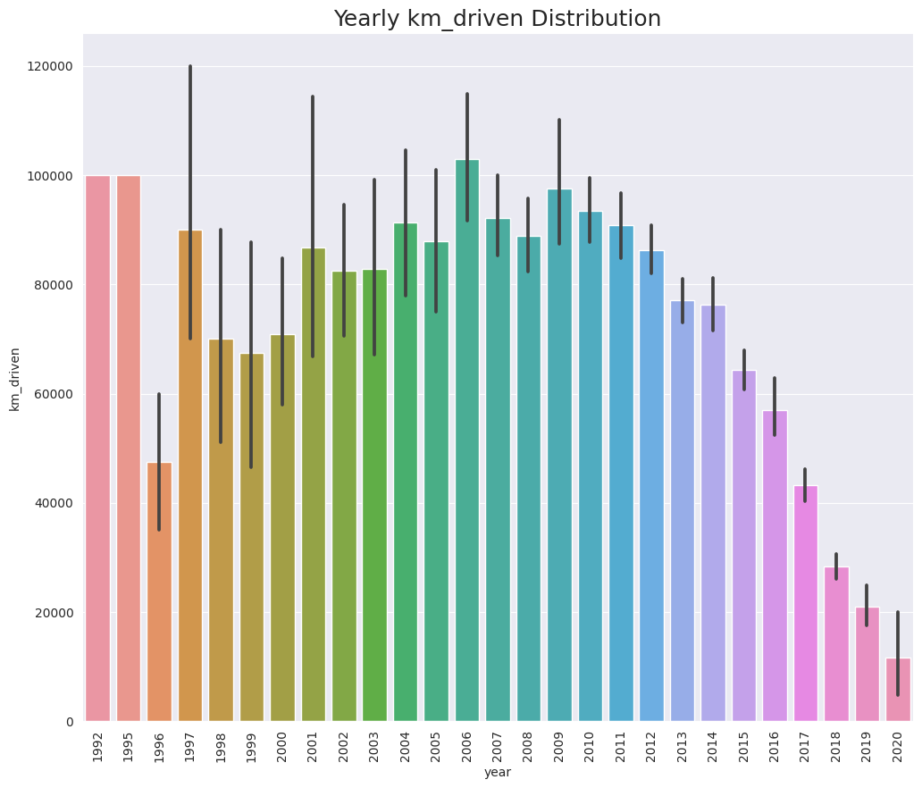
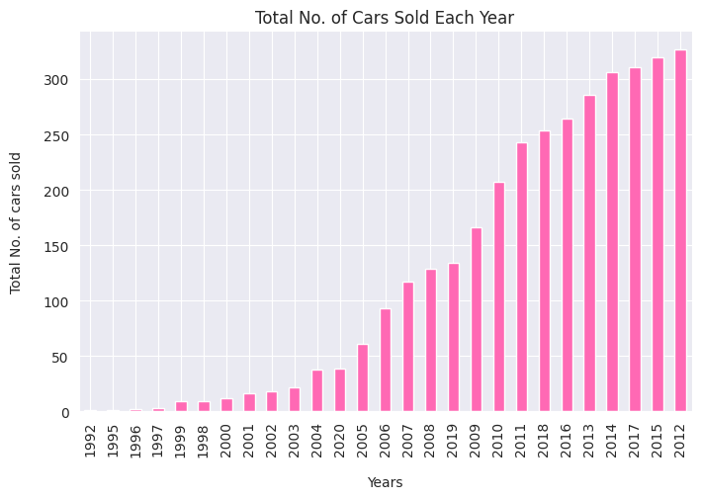
EDA Graphs

Slide 10
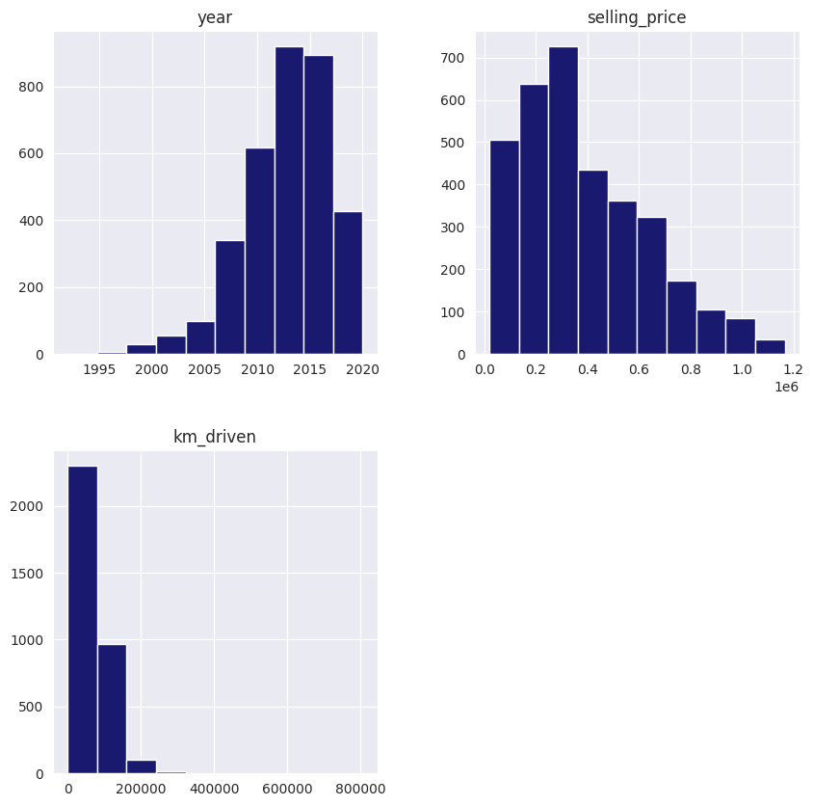
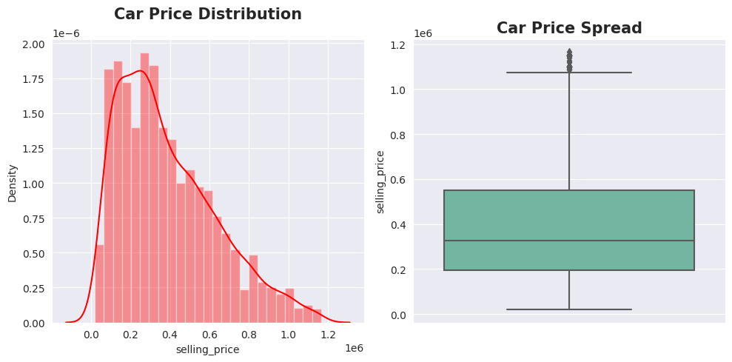
Graphical Analysis and Conclusion on Dataset
In the Exploratory Data Analysis (EDA) step of our project, we gained insights into the data through various visualizations. Firstly, we plotted the distribution of continuous columns and observed a large spike in the number of cars manufactured between 2011 and 2018. We also noticed that the graphs for kilometers driven and selling price had a similar unimodal distribution.
We can Observe that the selling price distribution is rightly skewed and there is no presence of outliers in the selling price feature.

Slide 11

Graphical Analysis and Conclusion on Dataset
Conclusion
Here I have used the updated car dataset which is taken from the car details dataset from Kaggle. Before applying Visualization , first i updated the dataset like perform some data cleaning , outliers removal and then i visualized the dataset using different visualization techniques(matplotlib and seaborn). I have used various plots in this like barplot, histplot, scatterplot, boxplot and many more. I also used correlation plot to check the correlation between different features, where I have found that With the increase in the year the selling price keeps on increasing , but the km_driven keeps on decreasing. I have also used pairplot to check the relationship between different features. From the Analysis I came to know that
The Top 5 Brands who sold the most number of cars are - Maruti, Hyundai, Tata, Ford and Mahindra.
Audi is one of the highest price car brand.
Mitsubishi car brand has the highest average km driven.
In the year 1997 the most km_driven cars are sold.
The Top 5 cars sold the most number of times are - Maruti Swift Dzire VDI, Maruti Alto 800 LXI, Maruti Alto LXi, Maruti Alto LX, Maruti Swift VDI BSIV.
In 2012, Manual Transmission cars sold the most.
In 2017, Automatic Transmission cars sold the Highest.
The Highest number of cars sold in 2012
Customers mostly prefer manual type cars.
Cars are mostly sold to first and second owners.

Slide 12
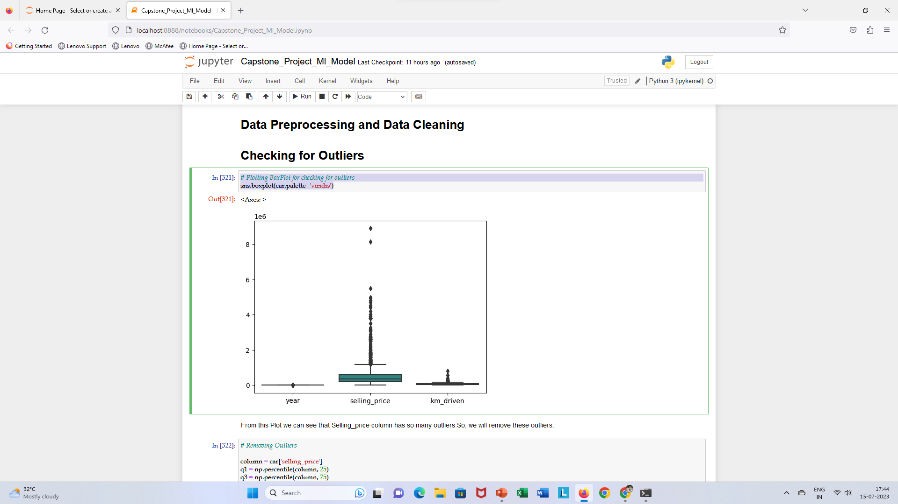
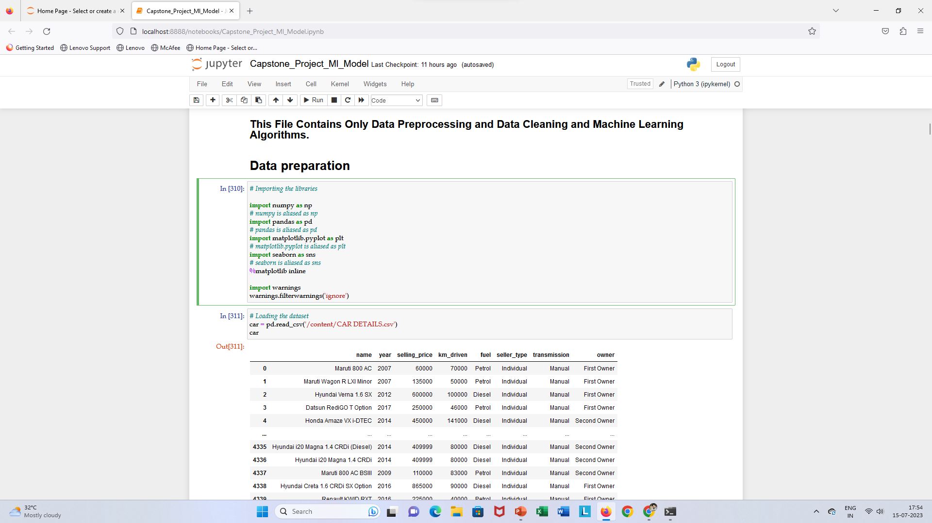
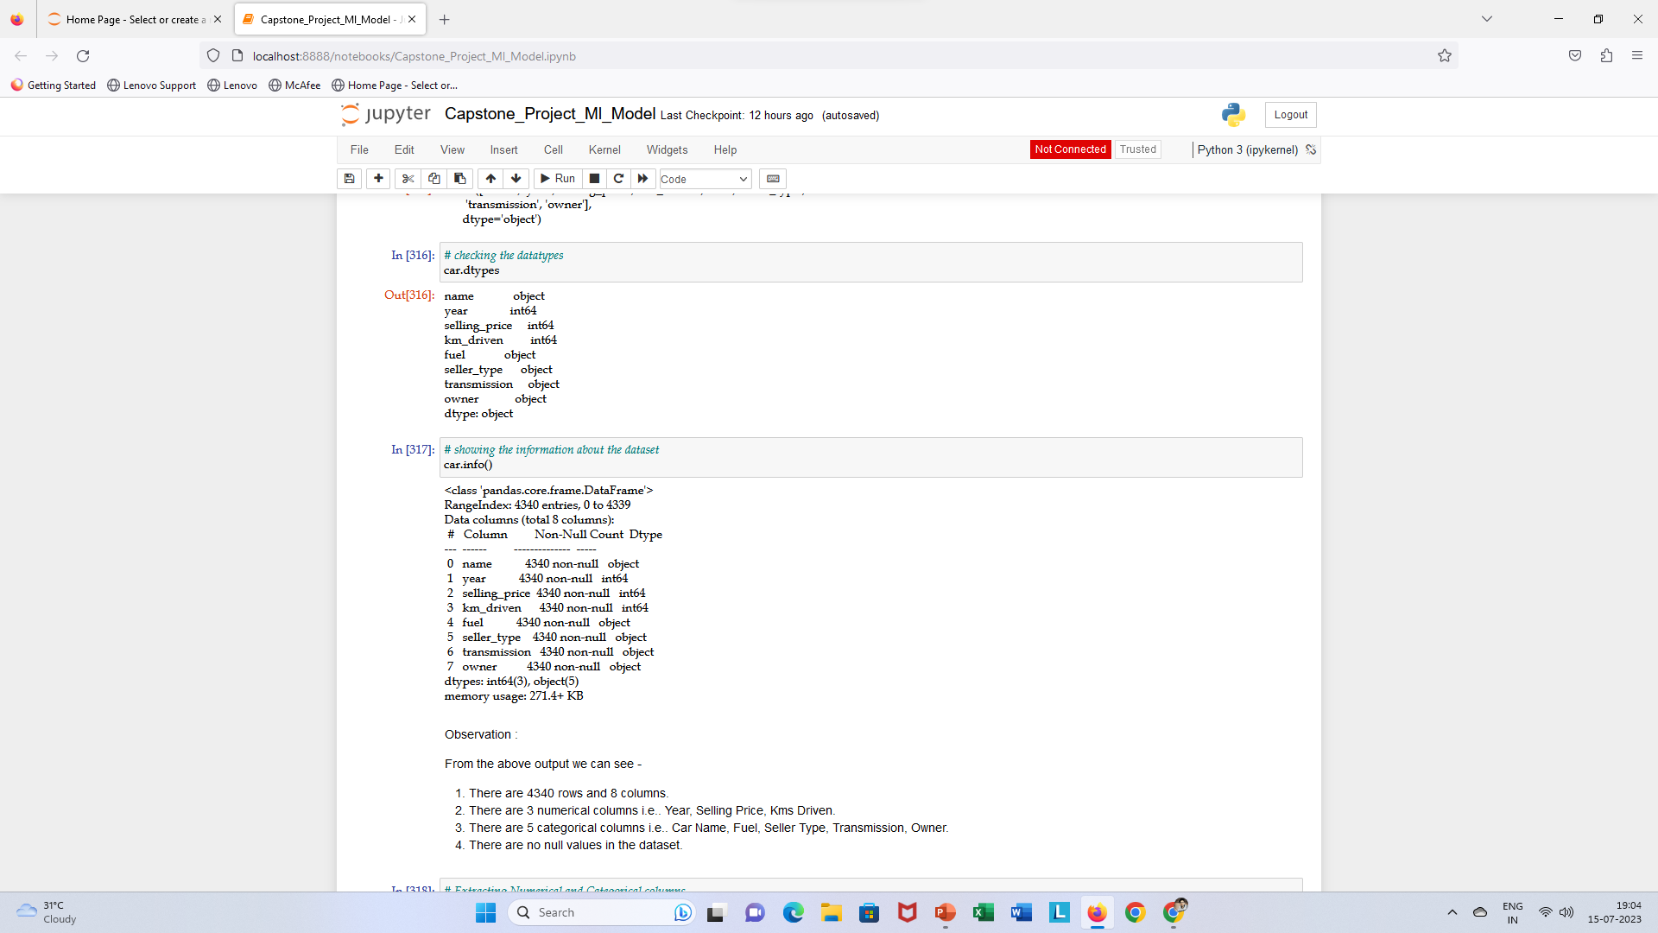
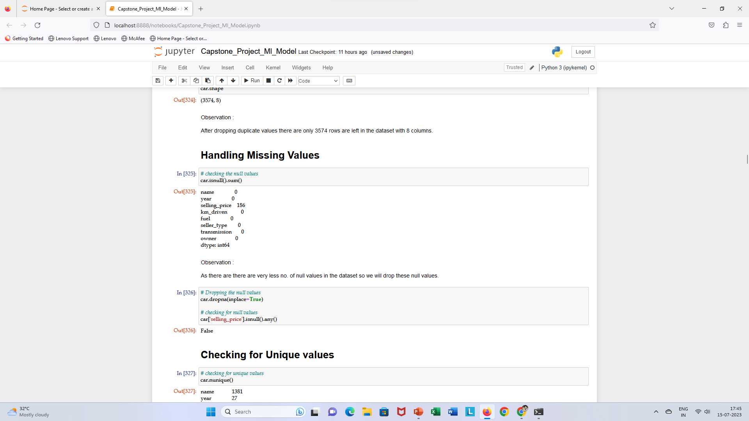
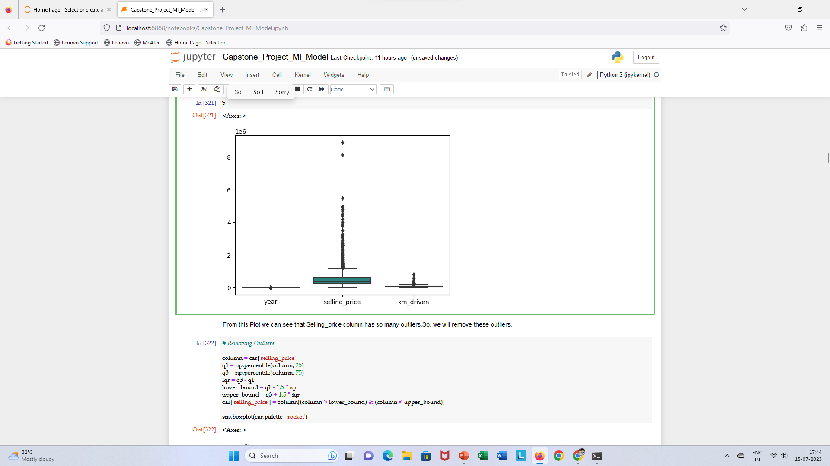
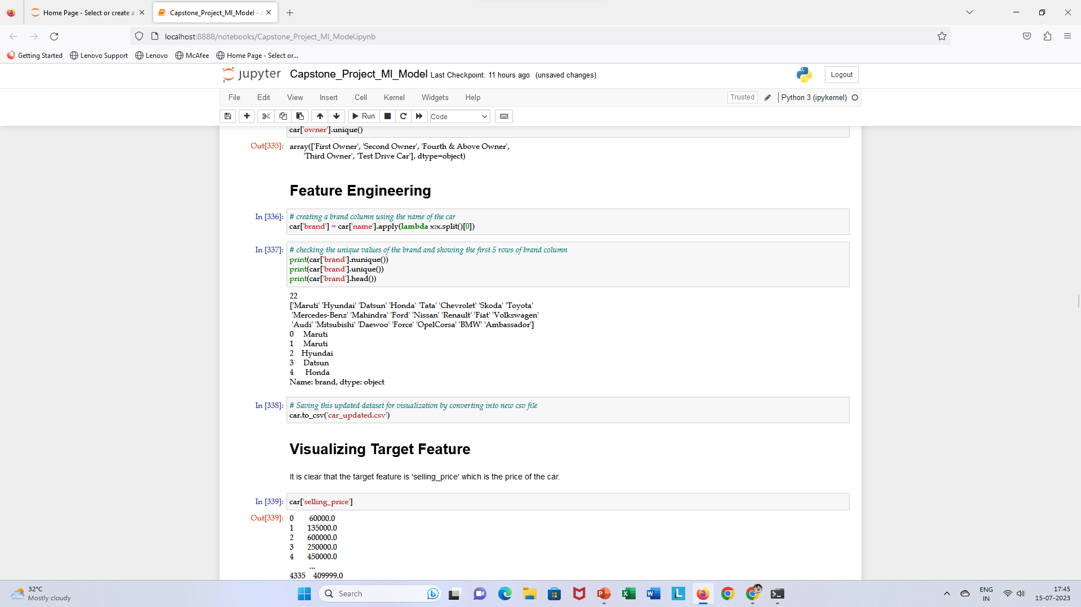
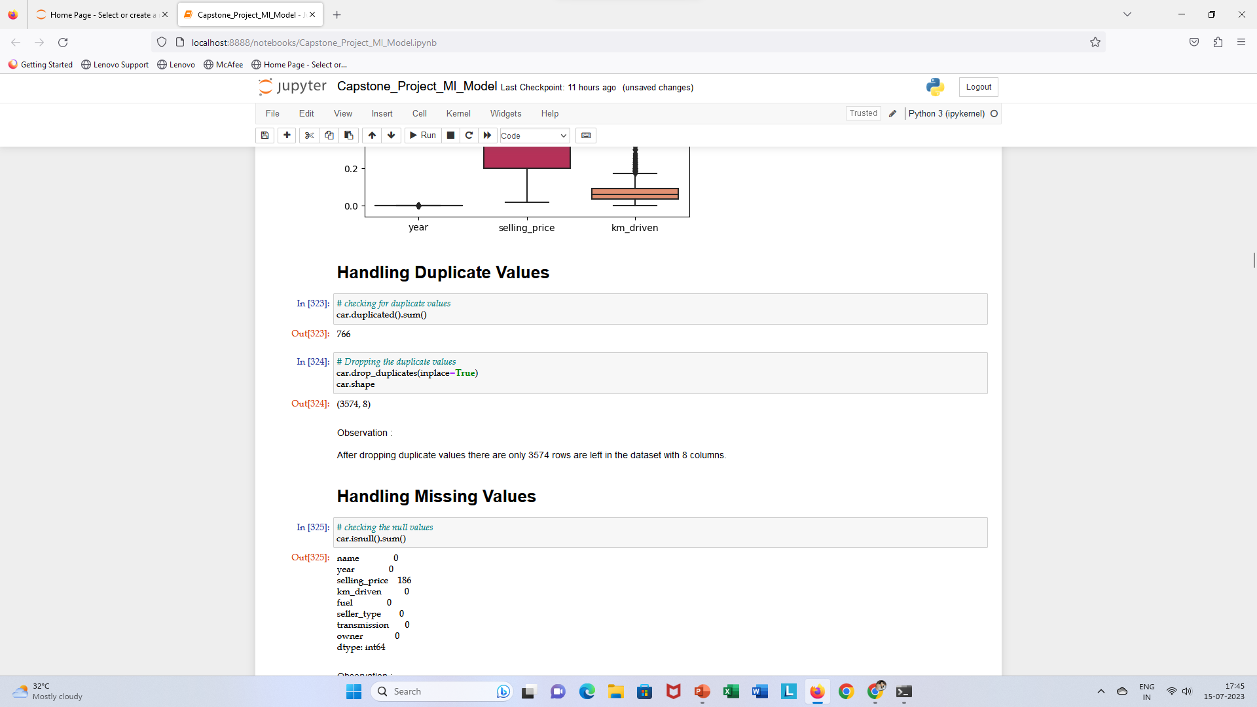
Data Cleaning and Data Preprocessing steps
Our data was already in good shape with appropriate data types. In this dataset I have performed basic data cleaning and data preprocessing like Handling missing values (dropping) from selling price column, also dropped some duplicated values, finding outliers in selling price column using boxplot and then removing such outliers using IQR method, also performed feature engineering where but I took the additional step of separating the brand name and car name into separate columns for better understanding of dataset. After performing all these steps, now data is ready to work for ml modelling. As a conclusion I can say, these final modifications will allow us to easily and effectively analyze the data in the following steps of the project.

Slide 13
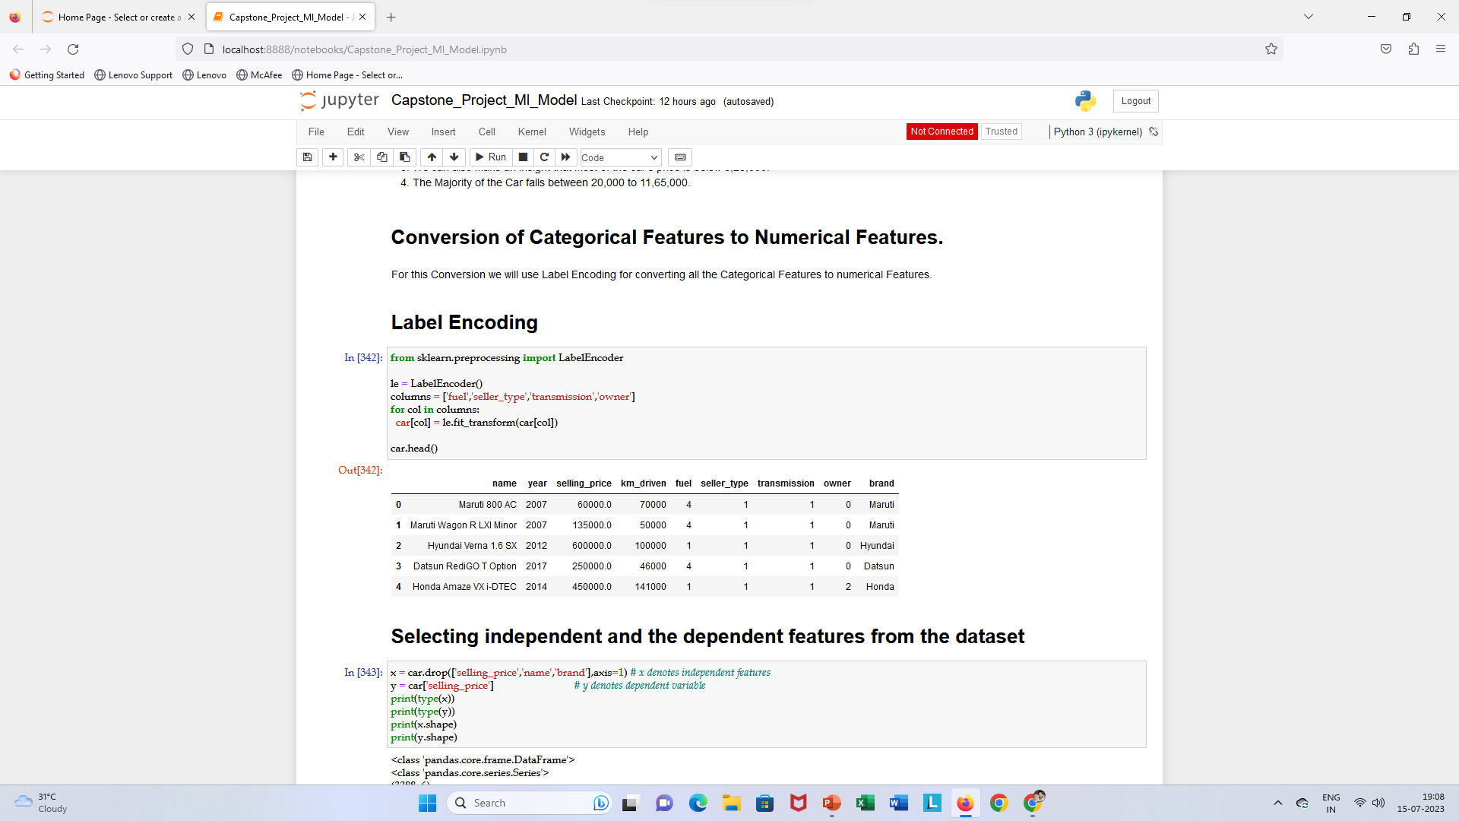
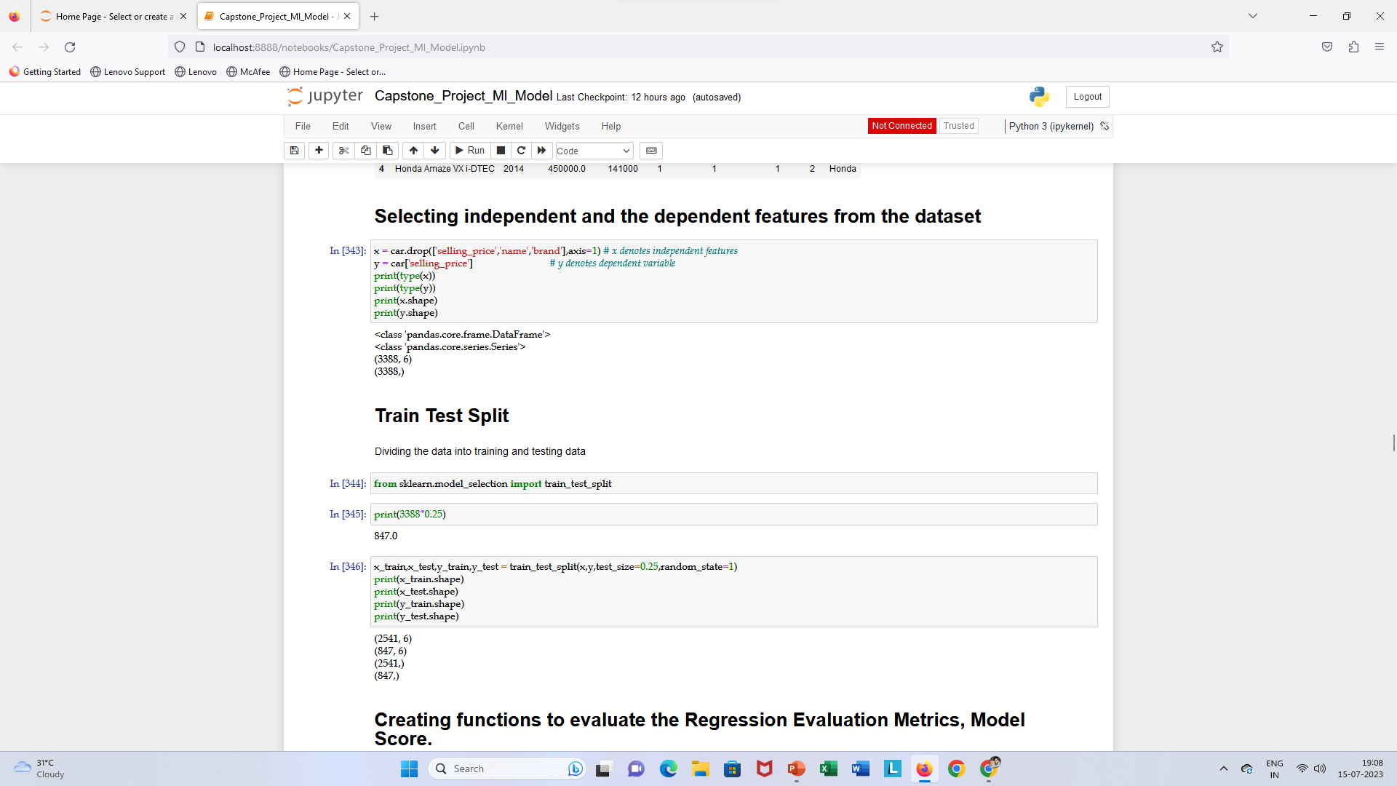
ML MODELING
In this first I have converted all the categorical columns into numerical columns using label encoder() function which help dataset to work smoothly. Then, selected dependent and independent feature and then I have performed train test split where I have giving 25 % data for testing on the basis of 75 % training data which help to predict the selling price of the cars.

Slide 14
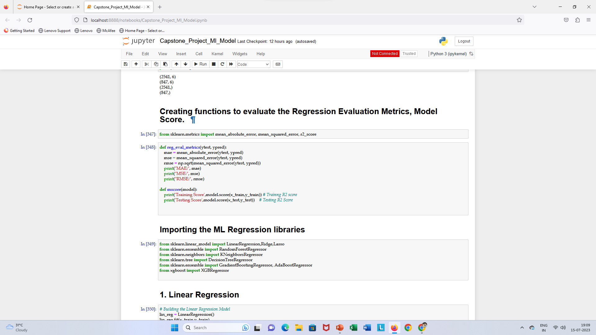
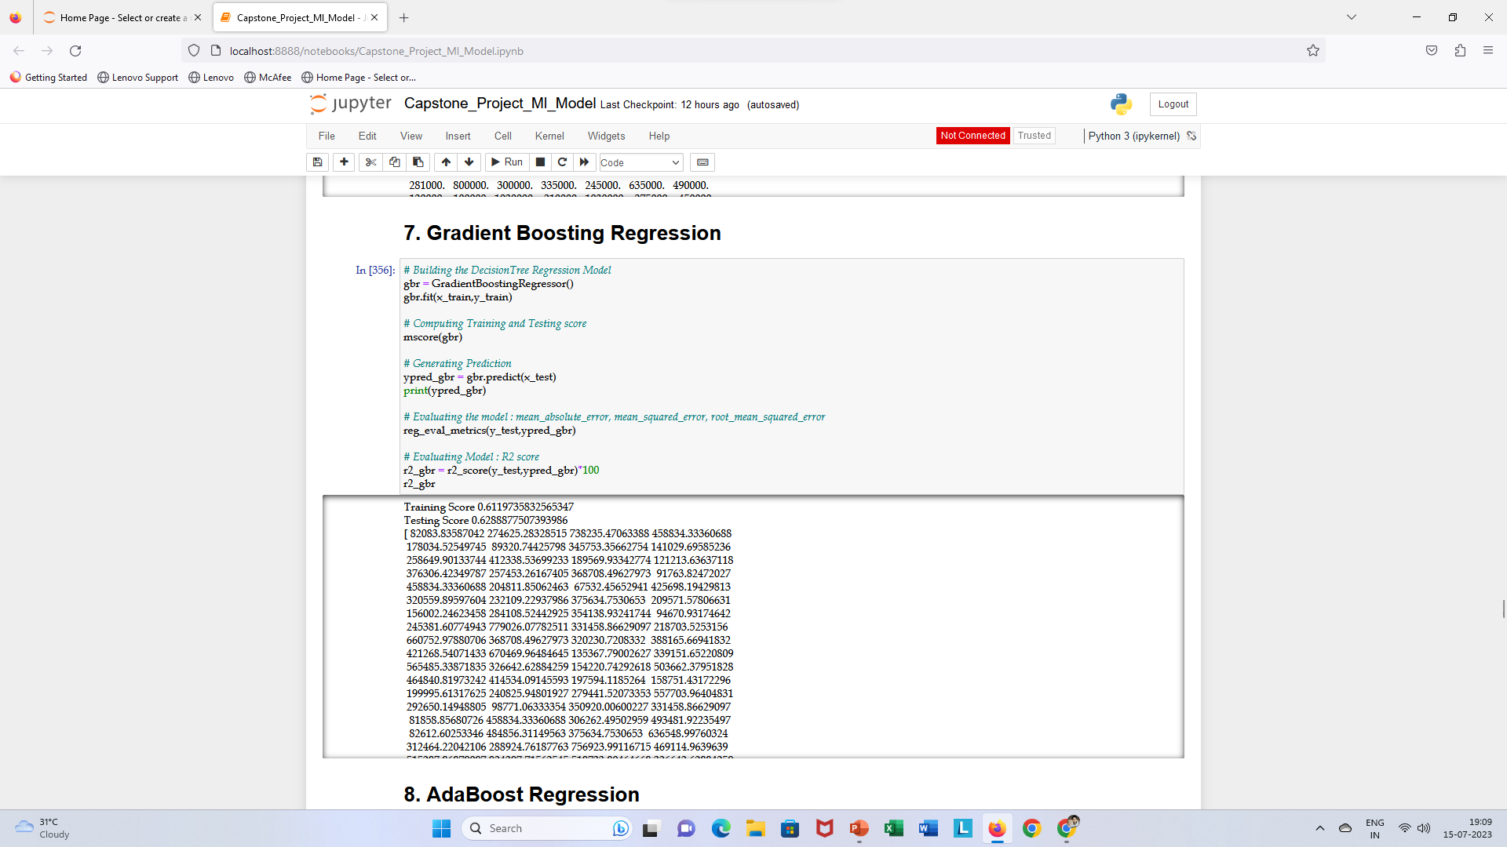
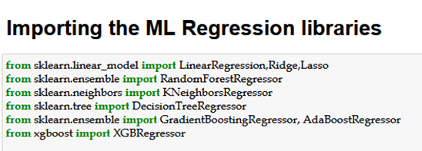
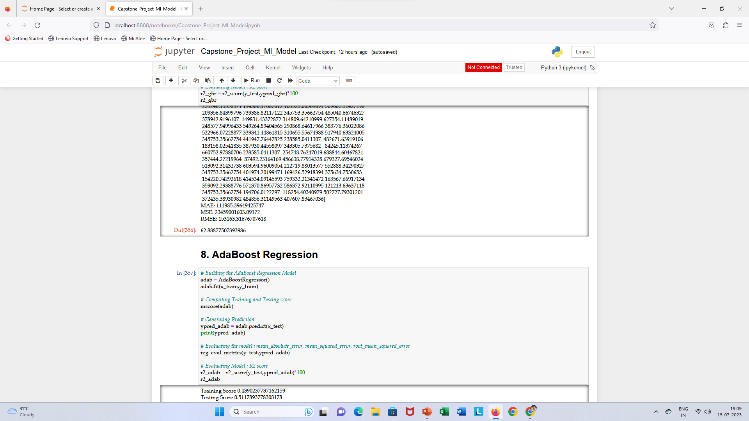
ML Modeling
Created a function to evaluate Regression Evaluation Metrics , Model Score where It gives the R2 score on the basis of which we defining the best model means the more the R2 score is the best the model works.
Showing Best Model
Imported some Important libraries.
In this I have build 7 Regression models…
Linear Regression
Lasso Regression
Ridge Regression
Knn Regressor
DecisionTree Regressor
Gradient BoostingRegressor
AdaBoost Regressor
XGBRegressor
The best model from all the models is Gradient Boosting regressor which gave 62 % accuracy which is more than any other models.

Slide 15
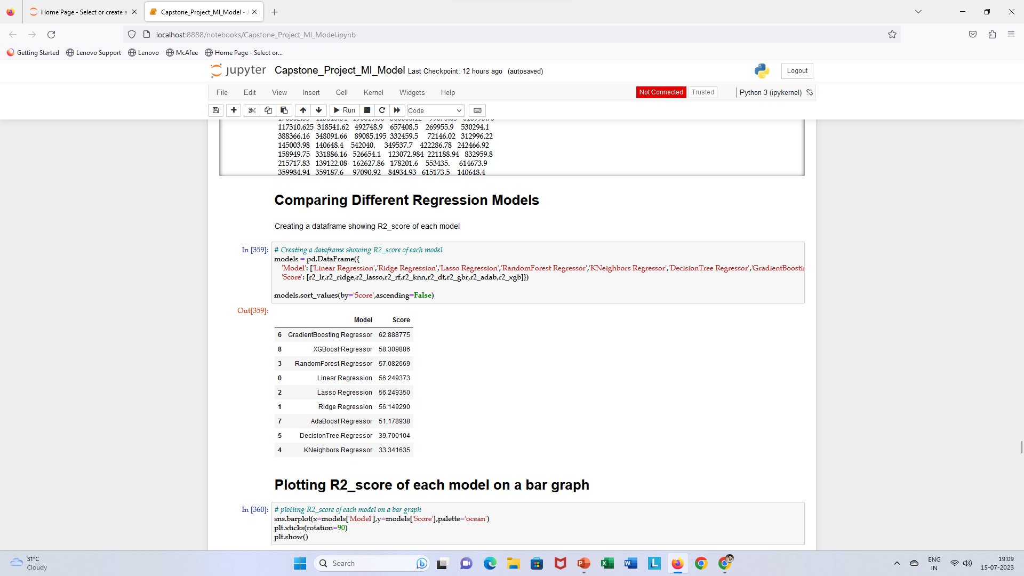
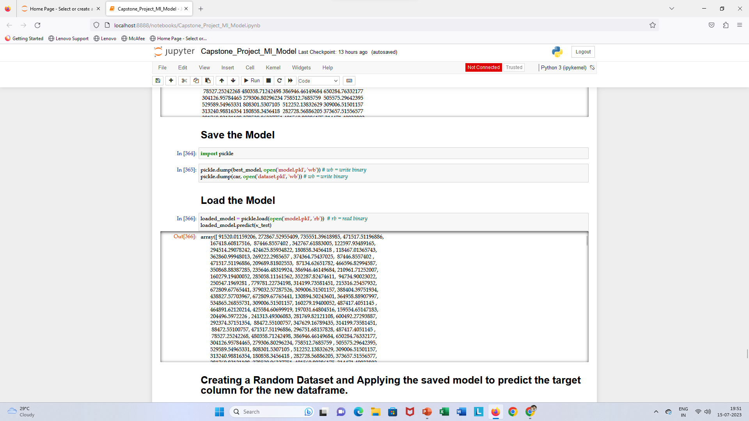
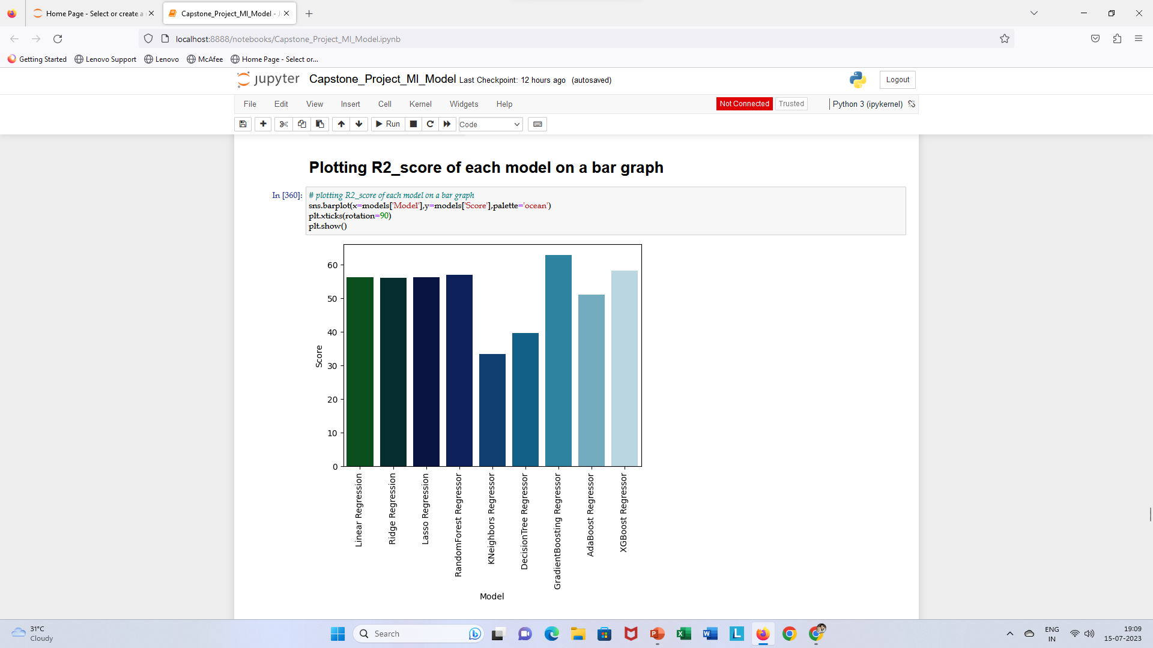
ML Modeling
Saving and loading the best model using pickle library .

Slide 16
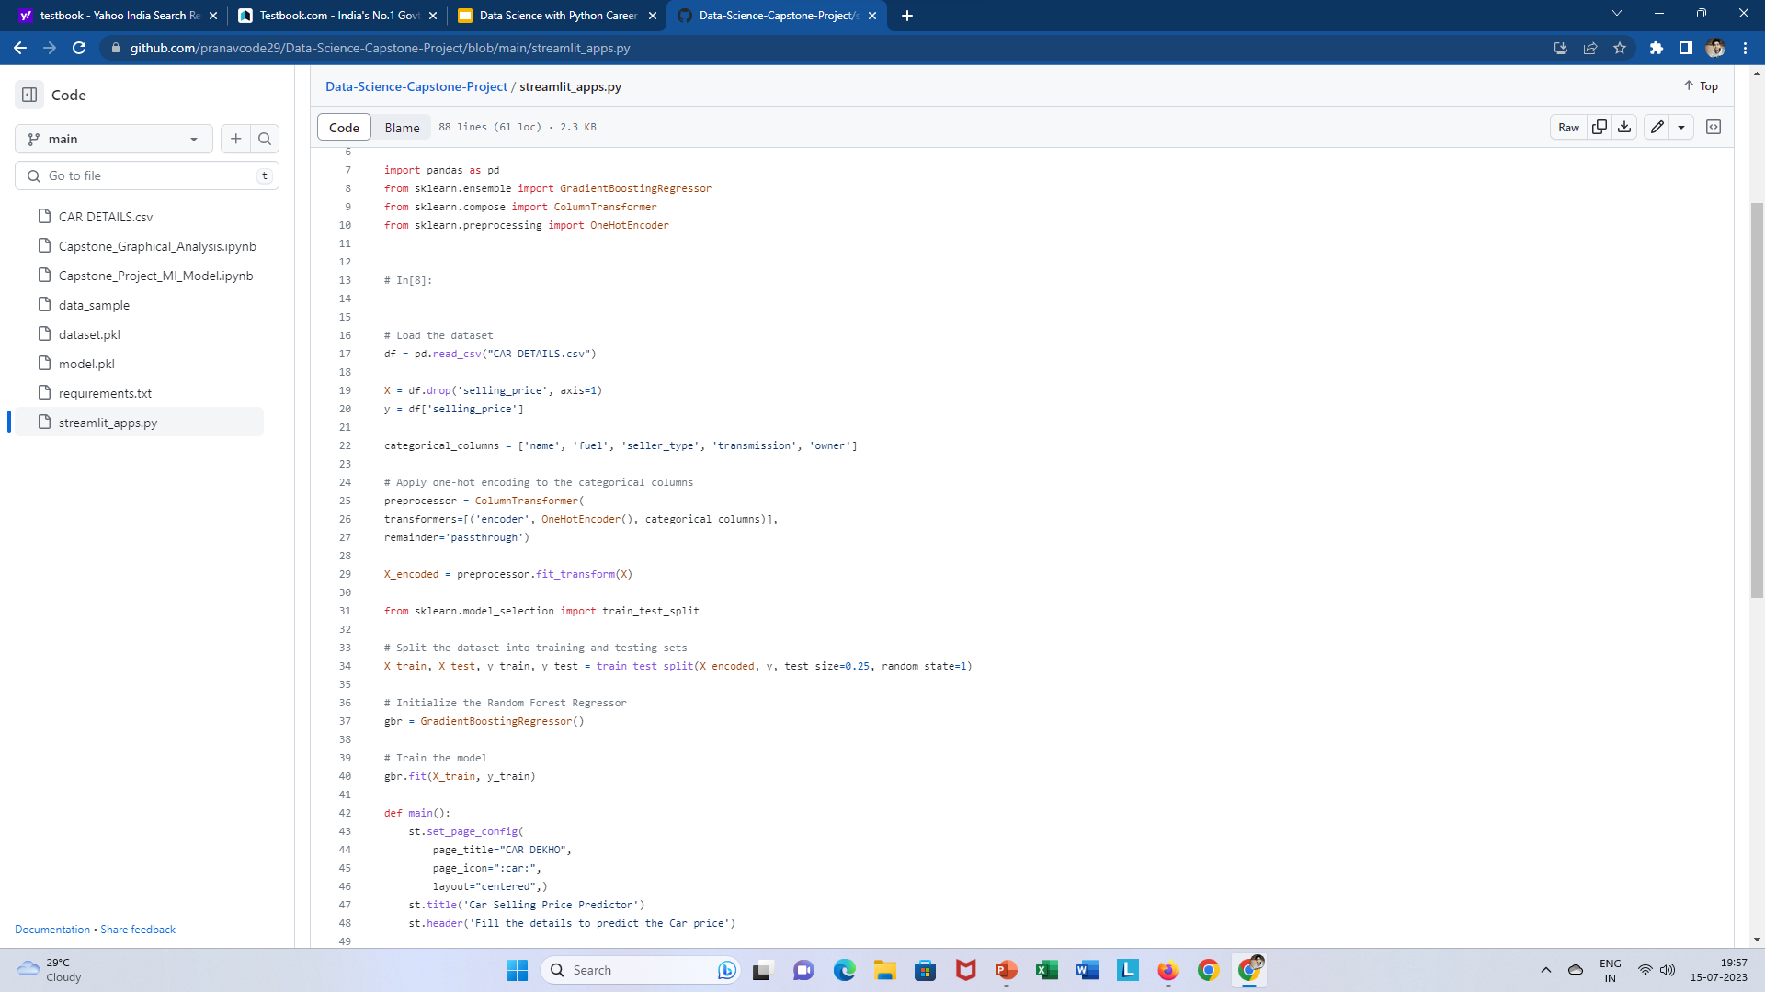
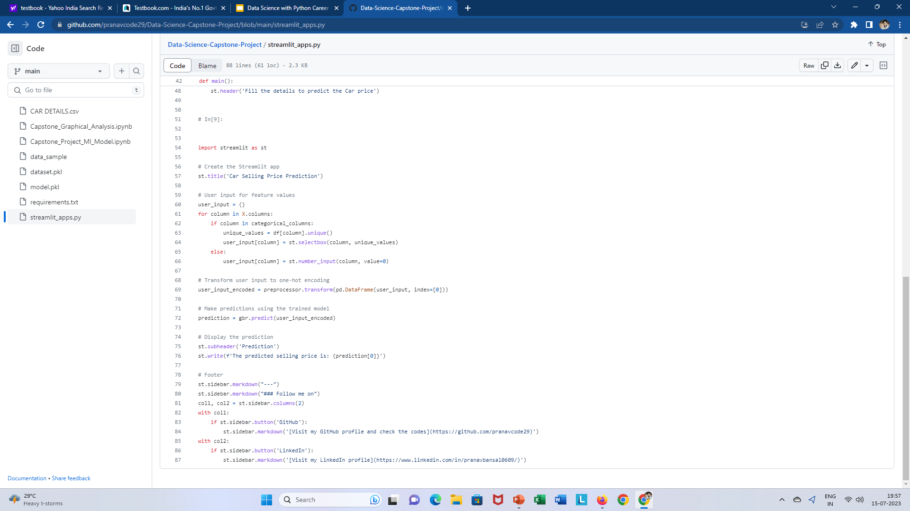
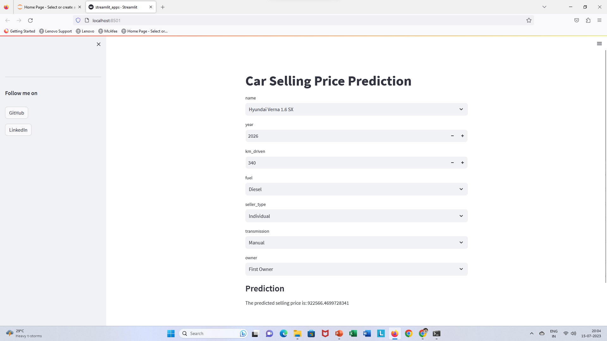
Deployment of ML Models using Streamlit
In the final step of the project, I created a Streamlit app for predicting the selling price of used cars. I utilized the Streamlit library to build an interactive and user-friendly application that could provide instant predictions based on the input data. The app was titled "Car Selling Price Prediction" and had a user-friendly interface that consisted of select boxes for 7 columns: car name, fuel type, seller type, transmission, owner, and a number input for the kilometers driven and year. After the user inputs the required data, it generate the prediction of the car's selling price, which was calculated using the saved machine learning model from the previous step. This Streamlit app was an effective tool that allowed users to easily predict the selling price of used cars and make informed decisions.

Slide 17
Conclusion
In conclusion, this data science project aimed at predicting the selling price of used cars in the second-hand market based on several factors such as the kilometers driven, year, fuel type, owner, seller type, and transmission. Through the various steps of data cleaning, exploratory data analysis, and model building, we were able to build a highly accurate Gradient Boosting Regressor model with an R2 Score of over 62%. The final step of deploying the model into a Streamlit app made it easy for users to access and generate predictions instantly. However, it is important to note that the accuracy of the model could be improved further by incorporating additional information such as the mileage, condition, and other relevant factors. Nevertheless, the results of this project demonstrate the power of machine learning in providing valuable insights and predictions in the second-hand car market.

Slide 18
References
Tools Used : MS Excel, Jupyter Notebook, Python, NumPy, Pandas, Matplotlib, Seaborn, Scikit Learn, Streamlit.
GitHub link :Data Science Capstone Project Github Repo Link
Streamlit Link : Streamlit app link

